Slide 1
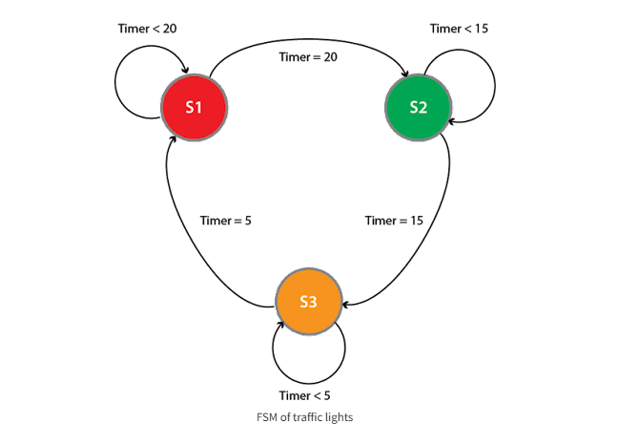
Tutorial-15
“Design a FSM for Traffic Light Controller using three states.” The attached state diagram can be used as a reference.
11/4/22

